Slide 1


C A P S T O N E P R O J E C T - FA L L 2 0 2 5
G O L D E N E Y E
Autonomous Human Detection for Desert Environments
Edge AI Processing
YOLOv8 Detection
Offline Operation
GPS Logging
Team: Hamza Jad Allah | Suhaib Alajami | Omar Malkawi Supervisor: Dr. Rami Al-Ouran

Slide 2






Presentation Agenda
1 Brief Introduction
2 Motivation and Problem Statement
3 Related Work / Applications | 4 | Proposed Solution (Our Work)
5 System Overview | 6 | Key Functionalities
7 UML / Architecture Diagrams | 8 | Methodology / Development Plan
9 Tools, Frameworks and Approach | 10 | Expected Outcomes
11 Scope and Limitations | 12 | References
GoldenEye - AI SAR Drone System
2

Slide 3
01
Brief Introduction
Project overview and context

Slide 4





Project Introduction
The Challenge
Desert landscapes of the Middle East (Rub al Khali, UAE, Wadi Rum) pose severe challenges to Search and Rescue operations.
Traditional methods are resource-intensive and slow
Remote regions lack cellular network coverage
Cloud-based drone solutions ineffective offline
Human fatigue limits ground patrol effectiveness
Our Solution
Autonomous UAV with Edge AI
Self-contained payload with onboard processing for signal-denied environments.
Real-Time Detection
YOLO-based model runs locally at 60 FPS without internet connectivity.
GoldenEye - AI SAR Drone System
4

Slide 5
02
Motivation and Problem Statement
Why this solution is critically needed

Slide 6







Motivation: The Humanitarian Crisis
142+
MISSING PERSONS (SAUDI, ANNUAL)
28
CONFIRMED DEATHS (HEAT/DEHYDRATION)
60
CRITICAL MINUTES (GOLDEN HOUR)
$4000
HELICOPTER COST PER HOUR
Time is Critical
Most deaths occur because victims cannot be located within 60 minutes, the window where medical intervention is most effective.
Cost Asymmetry
Our drone operates at less than per charge vs 4000/hr for helicopters. Enables proactive patrol swarms.
GoldenEye - AI SAR Drone System
6

Slide 7





Problem Statement
Search and Rescue operations in desert environments are time-critical and resource-intensive, relying on manual ground searches or manned aerial surveys that are slow, costly, and expose rescue teams to significant risks.
Environmental Challenges
Technical Gaps
Operational Constraints
Harsh lighting / glare
AI models not desert-tuned
No cloud connectivity
Sand-colored backgrounds
Edge deployment limits
Intermittent comms
Low visual contrast
Real-time processing needs
Vast search areas
Motion blur from UAV
Battery constraints
Extreme temperatures
GoldenEye - AI SAR Drone System
7

Slide 8
03
Related Work / Applications
Literature review and existing solutions

Slide 9





Related Work Analysis
Comprehensive review of UAV deployment in SAR: from Faster R-CNN to YOLOv8 and Transformer architectures, including MBZIRC and AUS Shaheen project findings.
Detection Algorithms
Two-stage (Faster R-CNN) vs Single-stage (YOLO) comparison. YOLOv8 shows best balance of speed and accuracy for edge deployment.
MBZIRC Challenge
Mohamed Bin Zayed International Robotics Challenge provides benchmarks for drone-based detection in harsh environments.
Shaheen Project
AUS students desert rescue innovation - pioneer work in regional SAR drone development with global recognition.
Key Gap Identified
Existing systems focus on accuracy metrics without considering real-world desert conditions, edge deployment, or offline operation.
GoldenEye - AI SAR Drone System
9

Slide 10
Related Work Analysis
Model Architecture | Dataset Context | mAP (0.5 IoU) | Inference Time (ms)
Faster R-CNN | HERIDAL (Wilderness) | 58.7% - 62.8% | 265 - 288
RetinaNet | HERIDAL (Wilderness) | 58.7% - 62.8% | 118 - 158
YOLOv5 | General Aerial | 75% - 80% | 15 - 30
YOLOv8 | HERIDAL (Wilderness) | 79.8% - 86.1% | 11.8 - 15
DCS-YOLOv8 | VisDrone (Small Obj.) | 44.5%* | Real-time (RK3588)
EfficientDet | SeaDrones/SARD | 97.3% | -
GoldenEye - AI SAR Drone System
9

Slide 11
04
Proposed Solution
Our work and application design
Notes:
Slide 10 - Section Header"Now let's move to our proposed solution - what we're actually building to address these challenges.“

Slide 12







Proposed Solution: GoldenEye System
An end-to-end AI-based SAR system that reliably detects humans in desert environments in real-time while accounting for environmental challenges and practical deployment constraints.
Domain Adaptation
Handles UAE dune glare and Wadi Rum Red Sands spectral signatures that confuse standard algorithms.
Thermal Crossover Fix
Prioritizes RGB optical detection during daylight when sand temps match human body heat.
Autonomous Logging
Logs GPS coordinates and captures timestamped images locally. Auto-returns to base on low battery.
Core Innovation
Platform-agnostic Modular Intelligent Payload - can mount on any UAV capable of carrying 500g. Focuses on computing, vision, and software integration.
GoldenEye - AI SAR Drone System
11
Notes:
Slide 11 - GoldenEye System"We call our system GoldenEye - an end-to-end AI-based search and rescue solution specifically designed for desert environments.Our system addresses three critical problems that existing solutions fail to handle:First, Domain Adaptation. Standard detection models struggle with UAE dune glare and the unique red spectral signatures of places like Wadi Rum. We've trained our model specifically on these conditions.Second, Thermal Crossover. Here's an interesting challenge: during peak daylight hours, desert sand heats up to nearly the same temperature as a human body - around 37 degrees. This makes thermal imaging useless. That's why we prioritize RGB optical detection during daylight operations.Third, Autonomous Logging. When we find someone, the system automatically logs GPS coordinates and captures timestamped images - all stored locally. If the battery runs low, it auto-returns to base without losing any data.The key innovation here is our Modular Intelligent Payload. This is platform-agnostic - it can mount on any UAV capable of carrying 500 grams. We focus on the computing, vision, and software - not the drone itself."

Slide 13
05
System Overview
Hardware and software architecture
Notes:
Slide 12 - Section Header"Let me walk you through how we actually built this - the hardware and software architecture."

Slide 14











Hardware Architecture: The Intelligent Payload
Raspberry Pi 5
8GB RAM
Quad-core Cortex-A76. Mission computer for
OS, telemetry, and flight controller communication.
Hailo-8L AI Kit
13 TOPS
M.2 HAT+ neural processing. Dedicated
exclusively to CV models - frees main CPU.
Camera Module 3
Wide FOV
CSI-2 interface. Wide variant maximizes field of
view for scanning larger terrain areas.
Camera
AI Processing
Pi 5 Logic
Flight Controller
GoldenEye - AI SAR Drone System
13
Notes:
Slide 13 - Hardware Architecture"Our Intelligent Payload consists of three main components:The Raspberry Pi 5 with 8GB RAM serves as our mission computer. It runs the operating system, handles telemetry, and communicates with the flight controller. The quad-core Cortex-A76 gives us plenty of processing power.The Hailo-8L AI Kit is our secret weapon. This M.2 HAT provides 13 TOPS of neural processing power - that's Tera Operations Per Second. It's dedicated exclusively to running our computer vision models, which frees up the main CPU for everything else.The Camera Module 3 Wide captures our video feed. We chose the wide variant specifically to maximize field of view - when you're scanning desert terrain from above, you want to cover as much ground as possible.As you can see in the flow diagram: camera captures frames, the AI HAT processes them with YOLOv8, the Pi 5 handles the logic, and then we communicate with the flight controller."

Slide 15





Software Architecture: Three-Tier Stack
Tier 1: Perception Layer
YOLOv8 Model AI HAT Runtime 60 FPS Processing Processes raw video frames to identify human targets in real-time. Tier 2: Logic Layer
Python 3.11 State Machine
Requires target in 5+ consecutive frames for Confirmed Find to prevent false alarms.
Tier 3: Control Layer
DroneKit-Python UART/USB Interface
Translates Confirmed Find into commands to halt drone and tag GPS location. Auto-RTB on low battery.
GoldenEye - AI SAR Drone System
14
Notes:
Slide 14 - Software Architecture"Our software follows a three-tier architecture:The Perception Layer is where the AI magic happens. YOLOv8 runs on the AI HAT, processing raw video frames at 60 frames per second to identify human targets.The Logic Layer is where we prevent false alarms. This is critical - we don't just detect once and alert. We require a target to appear in 5 or more consecutive frames before we call it a Confirmed Find. This dramatically reduces false positives from shadows, rocks, or debris.The Control Layer translates our detections into action. When we have a Confirmed Find, DroneKit-Python sends commands to halt the drone and tag the GPS location. And if the battery drops below a threshold, it automatically initiates Return to Base - because losing the payload in the desert helps no one."

Slide 16
06
Key Functionalities
Core capabilities of the system
Notes:
Slide 15 - Section Header"Let's break down exactly what our system can do - the core capabilities that make this effective for search and rescue."

Slide 17








Key Functionalities
Human Detection
Detect humans from aerial imagery with bounding boxes and confidence scores. Top- down and oblique angles.
Real-Time Inference
Detection from live video stream at 60 FPS. Continuous processing without frame drops.
Desert Robustness
Reliable in low contrast, harsh lighting, motion blur, and partial occlusion conditions.
Autonomous Processing
Operates with minimal user intervention once deployed. No manual selection required.
Visual Feedback
Displays detection results with bounding boxes overlay for operator review on ground station.
GPS Logging
Upon detection, logs precise GPS coordinates and captures timestamped images locally.
GoldenEye - AI SAR Drone System
16
Notes:
Slide 16 - Key Functionalities"We've designed six key functionalities:Human Detection - the core capability. We detect humans from aerial imagery, providing bounding boxes with confidence scores. This works from both top-down and oblique camera angles.Real-Time Inference - we process the live video stream at 60 FPS continuously. No frame drops, no lag. When you're searching for someone in the desert, every second counts.Desert Robustness - this is what sets us apart. Our system remains reliable in low contrast conditions, harsh lighting, motion blur from the UAV, and even partial occlusion when someone might be partially covered by sand or debris.Autonomous Processing - once the payload is deployed, it operates without human intervention. No operator sitting at a screen manually selecting targets. The system does the work.Visual Feedback - for the ground station operator, we overlay bounding boxes on the video feed. This allows for human verification when a detection occurs.GPS Logging - every detection is geotagged. We log precise coordinates and capture timestamped images. This data is stored locally, so even if we lose communication, the information isn't lost.Together, these capabilities create a system that can autonomously search large areas and reliably identify people who need help

Slide 18
07
UML / Architecture Diagrams
System design visualization

Slide 19

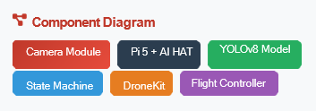
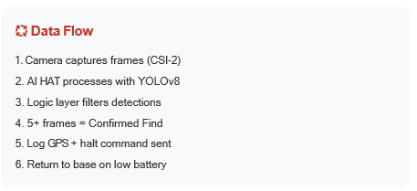

System Architecture Diagrams
Interface Note
Custom 3D-printed mount (PLA) houses Pi 5, AI HAT, and Camera - protects from dust/vibration with proper airflow cooling.
GoldenEye - AI SAR Drone System
18
Notes:
Slide Introduction
“This slide presents the overall system architecture and data flow of our autonomous search and rescue payload. It shows how visual data is captured, processed using edge AI, filtered through decision logic, and finally translated into drone control actions.”
Component Diagram
Camera Module
“At the input level, the camera module continuously captures aerial video frames. It connects to the Raspberry Pi using the CSI-2 interface, which provides high-bandwidth, low-latency image transfer suitable for real-time processing.”
Compute Layer – Raspberry Pi 5 & AI HAT
“The Raspberry Pi 5 acts as the main mission computer, handling system control, logging, and communication. At the same time, the AI HAT is dedicated solely to running the YOLOv8 model, providing hardware-accelerated inference and preventing overload on the main CPU.”
Perception Layer – YOLOv8
“YOLOv8 forms the perception layer of the system. It performs real-time human and vehicle detection directly on the edge device, without relying on cloud connectivity. This allows the drone to operate fully autonomously in signal-denied desert environments.”
Logic Layer – State Machine
This layer filters raw detections and reduces false positives by requiring a target to be detected consistently across five or more consecutive frames with high confidence before it is considered a confirmed find.”
Control Layer – DroneKit & Flight Controller
“Once a confirmed detection is made, the control layer—implemented using DroneKit—sends high-level commands to the flight controller. These include halting drone movement, logging precise GPS coordinates with a timestamp, and managing mission behavior such as returning to base when the battery reaches a critical level.”
Data Flow Summary
the pipeline follows a clear sequence: camera capture, edge-AI inference, logic-based confirmation, GPS logging, and autonomous control actions.”
Physical Interface – 3D-Printed Mount
“Physically, all components are housed in a custom 3D-printed PLA mount, designed to protect the system from dust and vibration while ensuring proper airflow for cooling. This is especially important for long missions in harsh desert conditions.
Slide Closing
“Overall, this architecture ensures the system is modular, autonomous, and robust, enabling real-time edge-AI decision-making under the environmental and computational constraints of desert search and rescue operations.”

Slide 20
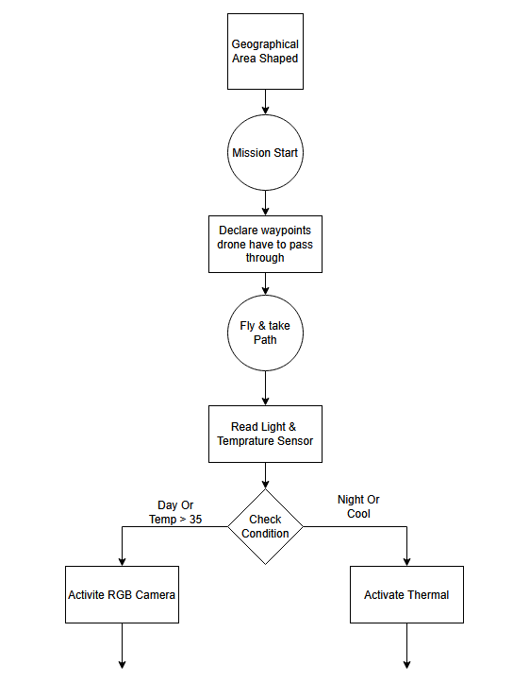
System Architecture Diagrams
GoldenEye - AI SAR Drone System
18

Slide 21
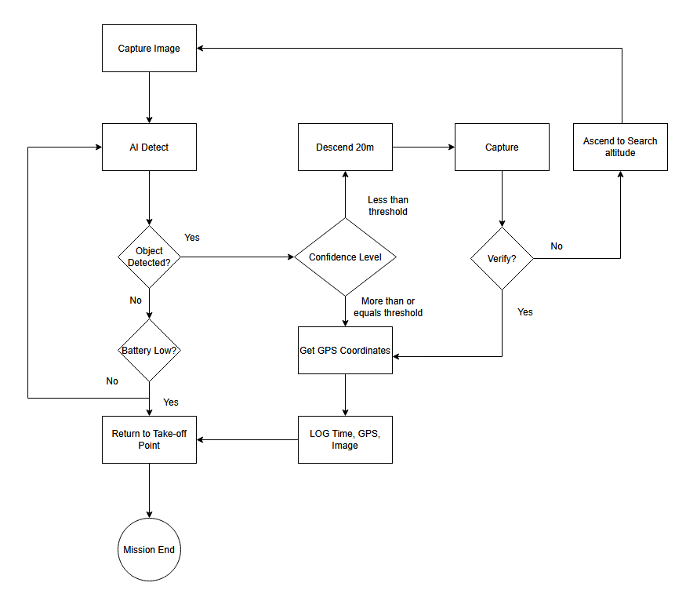
System Architecture Diagrams
GoldenEye - AI SAR Drone System
18

Slide 22
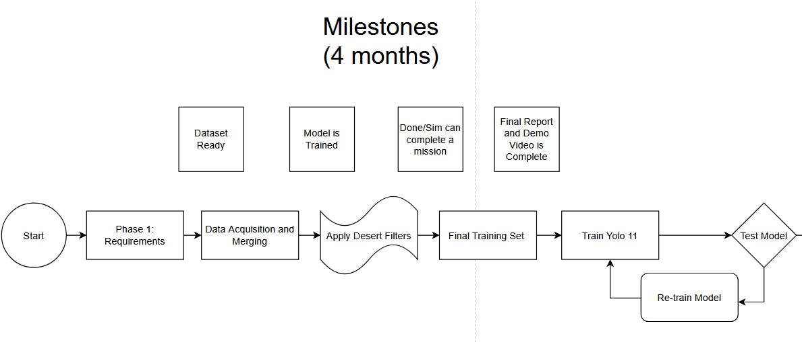
System Architecture Diagrams
YOLOv8 Model
v8

Slide 23
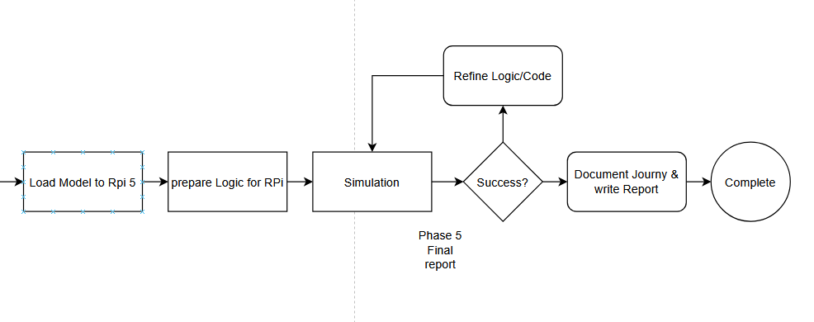
System Architecture Diagrams
YOLOv8 Model

Slide 24
08
Methodology / Development Plan
Project approach and timeline

Slide 25







Methodology and Development Plan
Phase 1: Research and Data Collection
Literature review, dataset collection (SARD, Caltech RGB-Thermal), and analysis of existing SAR solutions. Define project scope and requirements.
Phase 2: Model Development
Train YOLOv8 model with domain adaptation for desert environments. Optimize for top-down perspective detection. Target: greater than 95% mAP.
Phase 3: Hardware Integration
Deploy and optimize models on Raspberry Pi 5 with Hailo-8L AI HAT. Build custom enclosure. Integrate with camera and flight controller.
Phase 4: System Testing
End-to-end testing in simulated and controlled environments. Evaluate robustness under degraded conditions. Document performance metrics.
Phase 5: Validation and Documentation
System validation with proof of concept. Prepare final report, presentation, and software repository for delivery.
GoldenEye - AI SAR Drone System
20

Slide 26
09
Tools, Frameworks and Approach
Technology stack and implementation

Slide 27

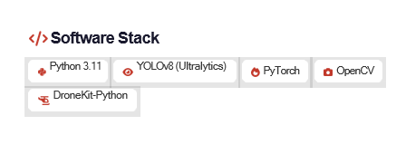
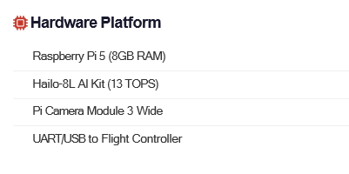
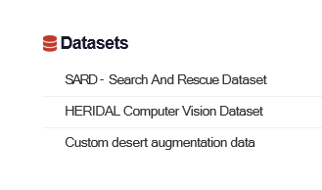
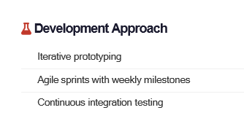

Tools, Frameworks and Approach
GoldenEye - AI SAR Drone System
22

Slide 28
10
Expected Outcomes
Project deliverables and results

Slide 29








Expected Outcomes and Deliverables
Technical Report
Complete academic document with problem definition, architecture, methodology, and evaluation.
Presentation
Formal slide deck and oral defense summarizing research, design, and implementation.
Hardware Prototype
Functional Intelligent Payload with Pi 5, Hailo-8L, and camera in custom enclosure.
Software Repository
Complete source: trained model, Python pipeline, and training/validation data.
System Validation
Proof of concept with test logs and video demonstrating autonomous detection.
Performance Metrics
Target: greater than 95% mAP, 60 FPS inference, desert robustness validation.
GoldenEye - AI SAR Drone System
24

Slide 30
11
Scope and Limitations
Project boundaries and constraints

Slide 31




Scope and Limitations
In Scope
Limitations
Custom YOLOv8 model for desert human detection
Testing in controlled/simulated environments only
Edge deployment on Raspberry Pi 5 with Hailo
Thermal imaging not prioritized (RGB focus)
Real-time inference (60 FPS target)
Battery life limits flight duration
Top-down and high-oblique perspective training
Training data may not cover all scenarios
Proof of concept demonstration
UAV platform not included (payload only)
Future Work
Real-world field testing, thermal sensor integration, multi-drone swarm coordination, and regulatory compliance for operational deployment.
GoldenEye - AI SAR Drone System
26

Slide 32
Thank You
G O L D E N E Y E
Questions and Discussion
AI-Based Search and Rescue Drone System
Hamza Jad Allah | Suhaib Alajami | Omar Malkawi
Supervised by Dr. Rami Al-Ouran

Slide 33


Key References
Human Detection from Aerial Imagery for SAR Operations - ResearchGate
AUS Shaheen Project for Desert Rescue Innovation - American University of Sharjah
Bringing Intelligence to SAR Missions: YOLO for Human Detection - IEEE Xplore
Real-Time Person Detection Using Thermal Images from Aerial Perspective - NIH PMC
DCS-YOLOv8: Context-Aware Network for Small Object Detection - MDPI
Thermal Human Detection for Search and Rescue UAVs - DiVA Portal
Benchmarking YOLOv5 for Improved Human Detection in SAR - ResearchGate
Archangel: A Hybrid UAV-based Human Detection - arXiv
UAV-YOLOv8: Small-Object-Detection Model for UAV Photography - NIH PMC
Human Detection in SAR Using Embedded AI - Jurnal Teknologi
Transformer-Based Person Detection in RGB-T Aerial Images - IEEE Xplore
SARD - Search And Rescue Dataset - Kaggle
Caltech Aerial RGB-Thermal Dataset - CaltechDATA
MBZIRC Grand Challenge and Finalist Teams - mbzirc.com
Aviation Solutions (2025). Helicopter Fuel Cost Per Hour
GoldenEye - AI SAR Drone System
27

